Slide 1





TEAM HEXAGON
PRESENTING
SHONDHAN

Slide 2
01
TEAM MEMBERS
SADIA AFRIN
NABILA NEWAZ
MEFTAUL JANNATI ANONNA
NAFISA HAQUE
KHAN MAHI AL ATAHAR
SAKIB AHMED SHANTO
210041209
210041216
210041227
210041231
210041260
210041262

Slide 3




02
SHONDHAN OVERVIEW
This mobile app that allows users to rent homes, lands, and commercial spaces using augmented reality (AR) to view real-time property details in their surroundings.
SHONDHAN
Enhanched Property Discovery
it features a robust host interface for property owners to manage listings, communicate with renters, and track property performance efficiently.

Slide 4

03
Why SHONDHAN ?
Simplifies property hunting, bringing the listings directly to the user’s surroundings.

Slide 5
04
KEY FEATURES
AR Property Viewing
Exploring rentals through Google maps
Advanced Search Filters

Slide 6
05
STAKEHOLDERS
HOME RENTERS
COMMERCIAL RENTERS
PROPERTY OWNERS

Slide 7
User interactions
06
Locate nearby properties through AR by simply pointing your phone.
Explore nearby properties through google map tags
Real-time information overlay, including price, features, availability, and contact options.
Easily update property details, add photos, and track views.
Communicate with potential renters and schedule viewings.

Slide 8
07
Tools and Technologies
FLUTTER
ANDROID STUDIO
FIREBASE

Slide 9



08
DEVELOPMENT MODEL
AGILE DEVELOPMENT (SCRUM)
Iterative development with continuous feedback.
Flexible adaptation based on feedback and evolving requirements.
encourages collaboration between cross-functional teams to achieve sprint goals.
focus on the end user's perspective (renters and property owners in your case)

Slide 10
09
WHY AGILE??
FLEXIBILITY
User-Centric
CONTINUOUS
DEVELOPEMENT

Slide 11





10
IMPACT ANALYSIS
Business :
-
Liabilities: High initial development costs and competitive market.
Benefits: Unique AR feature provides a competitive edge and attracts tech-savvy customers.
Perspectives
Environmental
-
Liabilities: Potential energy use from mobile device AR functionalities.
Benefits: Reduces the need for physical visits to properties, cutting down on emissions.
Financial
-
Liabilities: Initial funding required for AR development and data management.
Benefits: Long-term revenue from property listing subscriptions and premium features.

Slide 12


11
IMPACT ANALYSIS
Legal :
-
Liabilities: Ensuring compliance with data privacy laws.
Benefits: A legally compliant platform builds trust with users and property owners.
Perspectives
END-USER :
-
Liabilities: Inaccurate or delayed AR data could frustrate users.
Benefits: Enhanced user experience with real-time property information and AR exploration.

Slide 13

12
CHALLENGES
User Adoption:
Encouraging both property owners and renters to adopt the platform.
AR Integration:
Developing a seamless AR experience for both iOS and Android.
Data Security:
Ensuring the privacy of users’ location and personal data.

Slide 14
13
GANTT CHART
TASK / PROCESS
Week
Week
Week
Week
Week
Week
Week
Week
Week
Week
Week
Week
1
2
3
4
5
6
7
8
9
10
11
12
Planning
Design Process
Front-end development
Back-end development
Testing,Evaluation and Risk Review
Documentation & Deployment

Slide 15
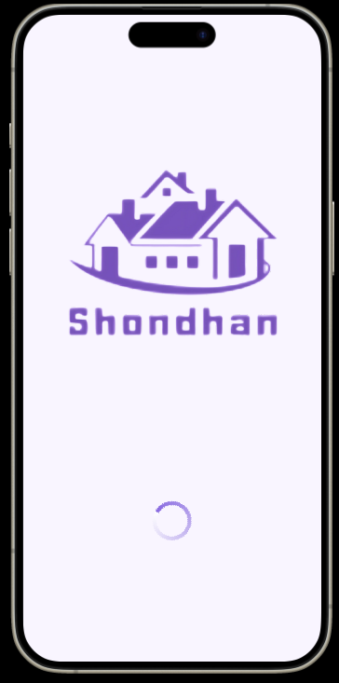
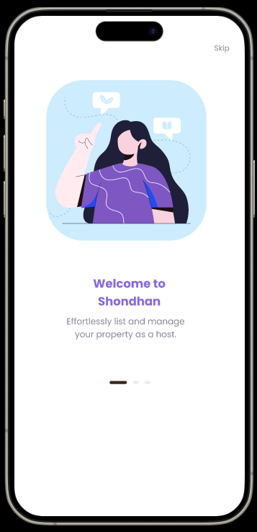
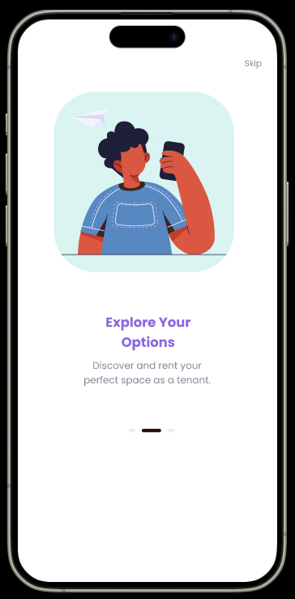
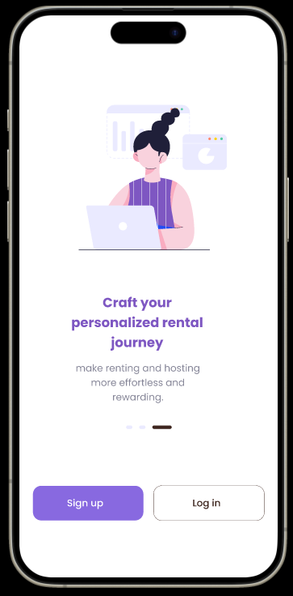
PROTOTYPE
14

Slide 16
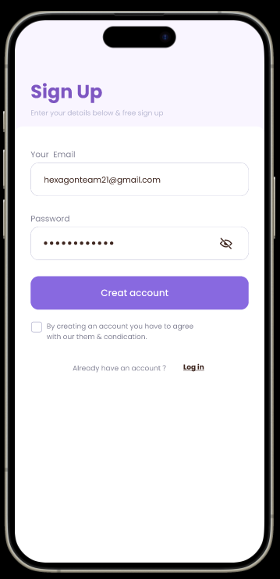
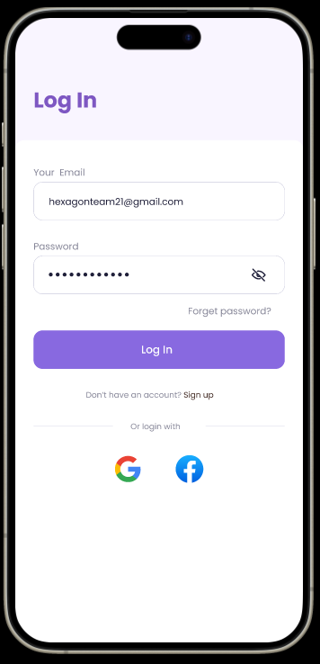
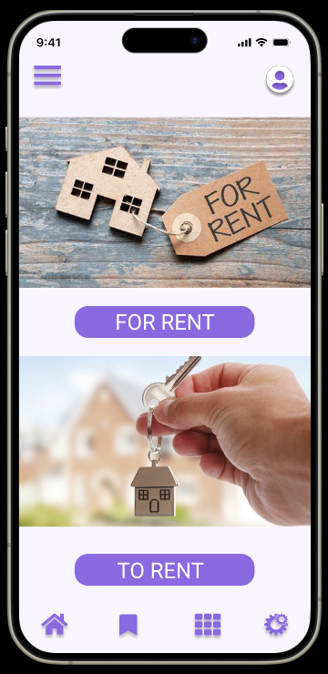
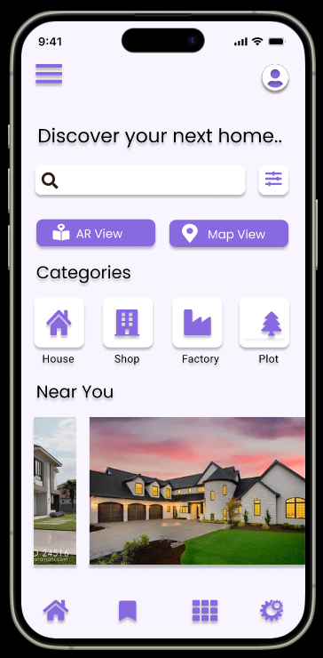
PROTOTYPE
15

Slide 17
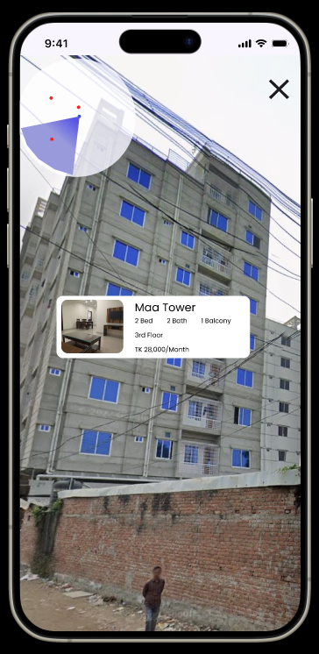
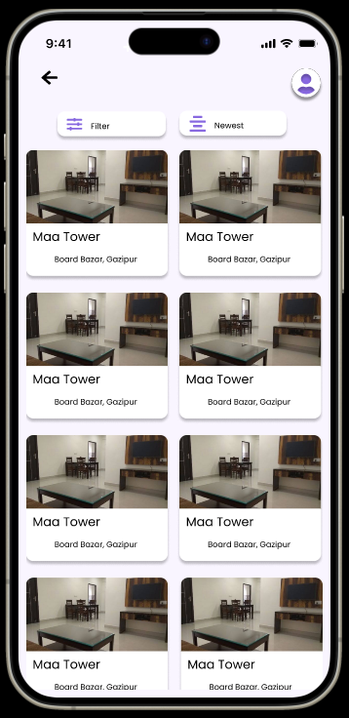
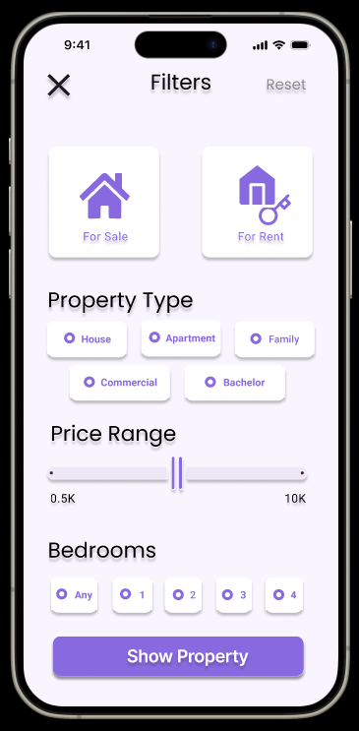
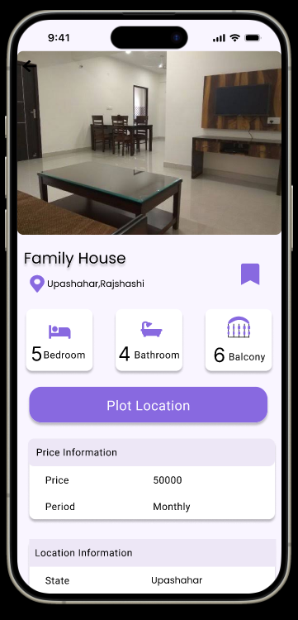
PROTOTYPE
16

Slide 18
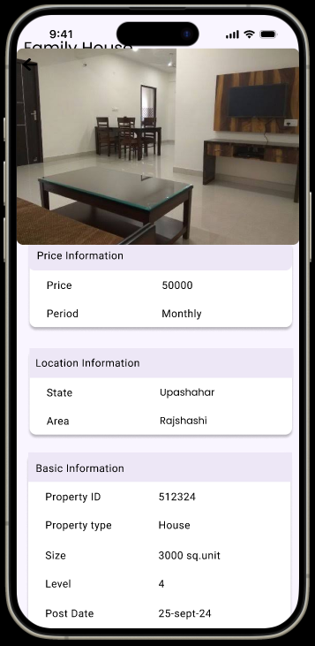
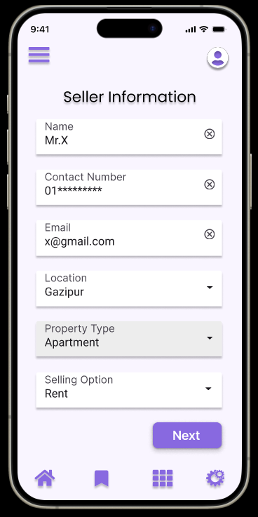
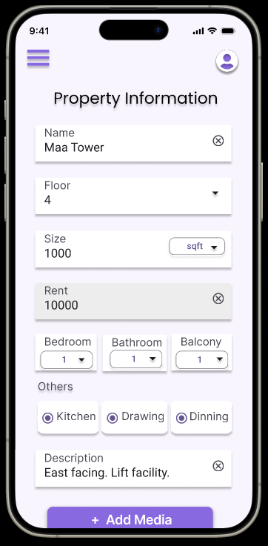
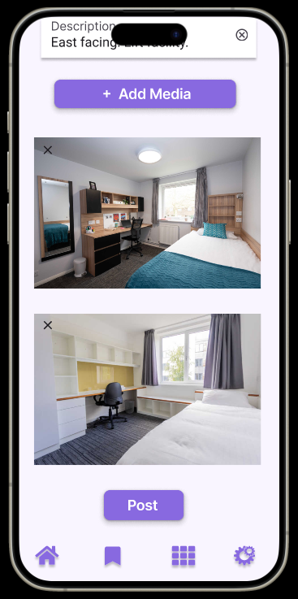
PROTOTYPE
17

Slide 19
18
QNA
THANK YOU!!!

